Slide 1

C# Programming Language
Stephen Marz
COSC365

Slide 2
Quick Actions
https://learn.microsoft.com/en-us/dotnet/csharp/
Language: https://learn.microsoft.com/en-us/dotnet/csharp/language-reference/
API: https://learn.microsoft.com/en-us/dotnet/api/
Async/await: https://learn.microsoft.com/en-us/dotnet/csharp/asynchronous-programming/
Download: https://dotnet.microsoft.com/download
Playground: https://dotnet.microsoft.com/en-us/platform/try-dotnet

Slide 3
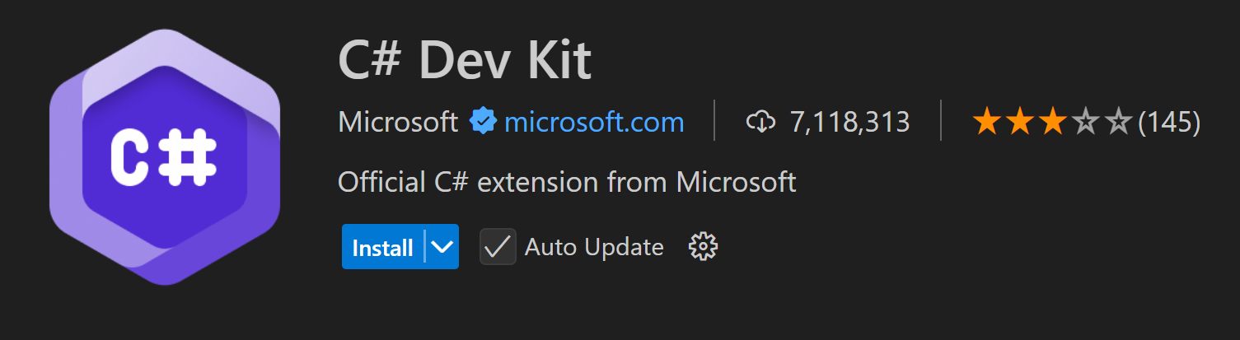
Development Plugin (VSCode)

Slide 4
C#
C# is:
imperative
procedural
compiled
object oriented
polymorphic
modular
strongly typed
statically typed
garbage collected
widely used in both government and industry

Slide 5
Imperative Programming
A series of instructions to change the state of the machine (e.g., memory, registers, I/O).
Examples: C, C++, C#, Java

Slide 6
Procedural Programming
A series of procedures (e.g., functions, lambdas, etc) that change state.
Procedural programming is a subset of imperative programming.

Slide 7
Compiled
The language is transformed into machine code or intermediate code before running.
Ahead-of-time (AoT) compilation – what you're used to with C, C++. The code is compiled to native instructions before it is run.
Just-in-time (JIT) compilation – translation from a bytecode into native instructions.
Interpreted languages, such as Python, are not JIT.
C# is JIT when using its intermediate language (MSIL).

Slide 8
Object Oriented
A style of programming that links data (fields) and actions (methods) in a set of memory called objects.
An object is a blueprint until it is instantiated.
Instantiation – allocating memory to store an object.

Slide 9
Polymorphic
A style of object-oriented programming allowing traits of one object to be derived to another.
Example:
Animal class
Animals can run, walk, eat
Tiger is an Animal
Don't have to reimplement run, walk, eat

Slide 10
Modular
Sections of code can be substituted.
C/C++ does this with headers and libraries.
C# takes this even farther with partial class definitions.
Classes can defined spanning multiple C# source code files.

Slide 11
Strongly Typed
Data must be explicitly converted.
Except for coercion (i.e., auto-casting)
C# does allow for unsafe typing, but this puts the onus on the programmer.

Slide 12
Statically Typed
C#'s types are checked at run time.
This differs from languages, such as Python, where the type is determined at run time.
Most progressively interpreted languages are dynamically typed.

Slide 13
Garbage Collected
Heap memory is automatically freed by the C# runtime.
Therefore, there is no delete keyword.

Slide 14
Naming Conventions
Interface names start with a capital I.
Identifiers shouldn't contain two consecutive underscore (_) characters.
Those names are reserved for compiler-generated identifiers.
Use PascalCase for class names and method names.
Use camelCase for method parameters and local variables.
Use PascalCase for constant names, both fields and local constants.
Private instance fields start with an underscore (_) and the remaining text is camelCased.

Slide 15
.NET
.NET is a framework of many classes that run on the CLR
CLI – Common Language Infrastructure
Many languages (C#, C++, and Visual Basic) run on the same virtual machine
CLR – Common Language Runtime
This is C#’s virtual machine that interprets MSIL
MSIL – Microsoft Intermediate Language
C#’s bytecode
When you compile C#, it transforms it into bytecode, not native assembly

Slide 16
C# Compiler
On hydra/tesla: "mcs"
-langversion:7.2
-out:myprogram.exe
mcs -langversion:7.2 -out:myprogram.exe myprogram.cs
Creates a .exe file
Called a "portable executable" or PE for short.
Must use "mono" to run .exe files:
mono myprogram.exe

Slide 17
Using `dotnet`
dotnet doesn't exist on Hydra/Tesla
Comes with many Linux distributions like Ubuntu or ArchLinux
dotnet new - creates a new project
dotnet build - builds project
dotnet run - runs the project
For newer C# versions, you must use dotnet.

Slide 18
C# Compiler and Runtime
C# compiles into MSIL
Microsoft Intermediate Language
MS's "bytecode"
Linker takes MSIL and generates a "portable executable" (PE)
C# runs on top of .NET
.NET is a virtual machine much like Java's VM
We use the "mono" virtual machine on Hydra/Tesla machines

Slide 19
Libraries
Libraries are added in the compiler command
Libraries are called assemblies.
Adding libraries is called linking an assembly.
System library is automatically linked.
Many things under the System library
using System;
Subclasses are not necessarily in the same assembly.
using System.Collections;
Is NOT in
using System;

Slide 20
Entry Point
Just like Java: C#'s Main() must be in a class.
public static void Main(string[] args)
Notice the capitalization of Main and string[].
This differs from Java's convention.
Java: public static void main(String[] args)

Slide 21
Primitives
Primitives: int, char, byte, long, string, uint (unsigned), ulong, float, double
Objective Primitives: Int16, Int32, Int64, Uint16, Uint32, Uint64
Arrays: int[], char[], long[], string[]
Structs are stack-based values
Classes are heap-based objects
Allocate a class using the “new” operator
There is NO delete
Uses garbage collection (GC)
Pointers function much the same way as C++
char *character_pointer;
int *integer_pointer;
Pointers should be avoided in C#

Slide 22
Arrays
Arrays are allocated on the heap
double[] many_doubles = new double[50];
Notice the data type itself has empty brackets []
Otherwise, the new operator functions much like C++
int[] many_ints = new int[] {1, 2, 3, 4, 5, 6, 7};
This form creates a new integer array with 7 elements
int[] ref_to_many_ints = many_ints;
In this case, ref_to_many_ints and many_ints point to the same memory location

Slide 23
Operators
Identical to C++
+ - * / % ++ --
== != >= <= < >
&& || !
& ^ | ~ << >>
= += -= *= /= %= <<= >>= &= ^= |=
sizeof() typeof()

Slide 24
Overloading
Many operators can be overloaded (defined by the programmer)
Fewer than C++ however
All operators are static and first argument is class object
Overloadable operators:
(unary and binary) +, -, !, ~, ++, --, true false
==, !=, <, >, >=, <=
&, |, ^, <<, >>
Non-overloadable:
&&, ||, [] (use indexers instead)
+=, -=, /=, %=, |=, ^=, >>=, <<=, and essentially any other combination operator

Slide 25
Flow Control
C# uses many of the same statements as C++
if
if...else if
if...else
switch
Ternary operator: ?

Slide 26
Auto-Derived Data
var keyword
var a = 1234; // a is an integer due to the literal 1234
var b = 1.2; // b is a double due to the literal 1.2

Slide 27
Converting and Casting
Casting is like C
var new_data = (type)data;
Class polymorphism uses as keyword
This is covered under the object-oriented section.
Converting data types can use the Convert class
https://learn.microsoft.com/en-us/dotnet/api/system.convert
Converting from string can use the Parse() functions.

Slide 28
Interpolated Strings
string hello = "Hello";
string value = $"{hello} World.";
Console.WriteLine(value);
for (var i = 0;i < 5;i+=1) {
Console.WriteLine($"Line {i + 1}");
}

Slide 29
Formatted Strings
$"{i, 10}"
Prints the variable i in a right-justified field, 10 characters wide
$"{i, -10}"
Prints the variable i in a left-justified field, 10 characters wide
$"{dbl, 6:F2}"
Prints the variable dbl in a right-justified field, 6 characters wide, in fixed notation with two digits of precision.

Slide 30
String Formats
E - scientific notation
Fdigits - fixed notation with digits number of digits right of the decimal.
N - number (puts in commas and decimal points)
P - percent
X - hexadecimal
Capital X -- all digits capitalized
Lowercase X -- all digits lowercase
Does not print leading 0x

Slide 31
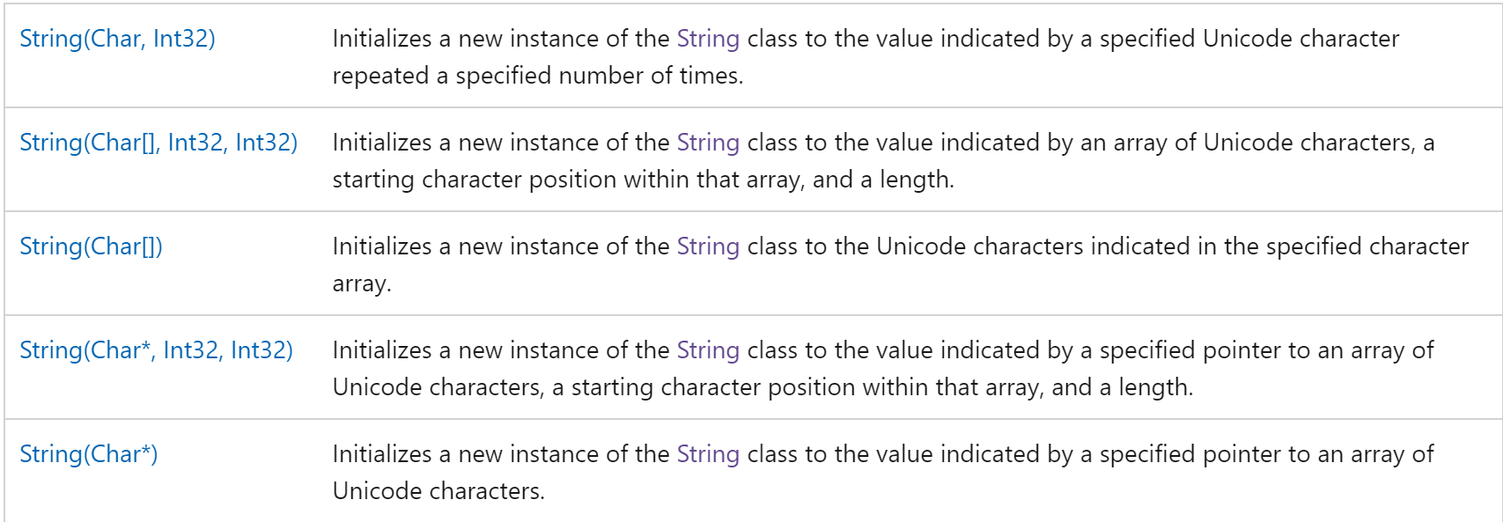
String Class
https://learn.microsoft.com/en-us/dotnet/api/system.string

Slide 32
Handling Null
string fileName = Console.ReadLine()?.Trim() ?? string.Empty;
https://learn.microsoft.com/en-us/dotnet/csharp/language-reference/operators/member-access-operators#null-conditional-operators--and-
Console.ReadLine()
Reads a line of input from the console and returns it as a string.
If the user enters nothing and just presses Enter, it will return an empty string (""), not null.
?.Trim()
The null conditional operator (?.) ensures that the Trim method is only called if Console.ReadLine() does not return null.
If Console.ReadLine() is null, the entire expression Console.ReadLine()?.Trim() will evaluate to null, and Trim will not be called, avoiding a NullReferenceException.
?? string.Empty
The null coalescing operator (??) provides a default value if the left-hand side is null.
If Console.ReadLine()?.Trim() evaluates to null (because Console.ReadLine() returned null), then fileName will be assigned an empty string (string.Empty).

Slide 33
Nullable Value Types
Value types do not hold null by default.
https://learn.microsoft.com/en-us/dotnet/csharp/language-reference/builtin-types/nullable-value-types
The ? syntax when declaring tells C# to also let the value type hold null.
double? pi = 3.14;
char? letter = 'a';
int m2 = 10;
int? m = m2;
bool? flag = null;
// An array of a nullable value type:
int?[] arr = new int?[10];

Slide 34
Data Conversions
System.Convert
https://learn.microsoft.com/en-us/dotnet/api/system.convert?view=net-8.0
var result = Convert.ToBool(value);
var result = Convert.ToInt32(7.95);
var result = Convert.ToSingle(7);

Slide 35
Built In String Parsing
System.String
https://learn.microsoft.com/en-us/dotnet/api/system.string?view=net-8.0
Strings can be converted to int/float by using Parse
int value = int.Parse("123");
double value = double.Parse("7.59");
string input = "Hello World!";
char[] string_chars = input.ToCharArray(6, input.Length);

Slide 36
Console
Console.Write("Something");
Writes the string to standard out.
Console.WriteLine("Something");
Writes the string and prints a newline at the end to standard out.
Console.Read()
Reads a single character from standard in as a char.
Console.ReadLine()
Reads a line from standard in as a string.
Returns null if ReadLine fails to read a line (e.g., EOF).

Slide 37
File I/O
Files are controlled through System.IO
BinaryReader
BinaryWriter
File
Path
FileInfo
FileNotFoundException
FileStream
StreamReader // implements TextReader for streams
StreamWriter // implements TextWriter for streams
TextReader // abstract base class
TextWriter // abstract base class
StringReader // istringstream equivalent
StringWriter // ostringstream equivalent

Slide 38
Exceptions
Just like C++
try/catch/throw
Try/Catch
https://learn.microsoft.com/en-us/dotnet/csharp/fundamentals/exceptions/exception-handling
You can create your own exceptions:
https://learn.microsoft.com/en-us/dotnet/csharp/fundamentals/exceptions/creating-and-throwing-exceptions

Slide 39
Exception Handling
try { }
Execute statements inside this block that might throw an exception
catch { }
Execute statements inside this block when an exception was thrown
use: catch (ExceptionName e1) { } to catch specific exceptions
finally { }
Execute a “final” set of statements regardless of whether or not an exception was thrown
throw – Throws an exception to a try{} catch{} block

Slide 40
Loops
for
foreach
while
do-while

Slide 41
For Loop
Same as C/C++/Java
for (initializer; condition; step) {
body
}

Slide 42
Foreach Loop
Same as Java/C++'s foreach loop
Except uses the keyword foreach
double[] array = new double[] { 1.1, 2.2, 3.3, 4.4, 5.5 };
foreach (var i in array[1..4]) {
Console.WriteLine($"{i}");
}
Can be used on primitives or classes that implement IEnumerable

Slide 43
While and Do-While Loops
Exactly like C++
while (condition) {
// body
}
do {
// body
} while (condition);

Slide 44
Classes
Much like C++
Each element has access protection (not a state like it is in C++)
Can contain: member functions, properties, variables, and events
All class objects inherit the top-level class called "object"
object is essentially a generic variable

Slide 45
Object Oriented Classes in C#
Everything is in a class
Can have several types of classes:
abstract – A class that cannot be instantiated, but can be inherited
sealed – A class that cannot be inherited
interface – An outline of a class, with no actual code
Classes have access protection just like C++
internal
public
protected
private
Classes’ method’s definitions are written in the class.
virtual – A method, property, or event that can be overridden by a derived class
Virtual methods invoke the derived class' methods even when passed as the base class.

Slide 46
Writing a Class
class MyClass
{
public MyClass() {
// Constructor that takes 0 arguments
}
public string Name { get; set; } // Property that is R/W
private int Secret; // Variable that is private
public readonly int year; // Public / readonly integer
}

Slide 47
Class Access Protection
class MyClass { } (is the same as internal class MyClass {} )
This class can only be seen by your "assembly"
Assemblies are what C# call libraries
public class MyClass { }
This class can be seen by any library or any other programmer's code that imports your library.

Slide 48
Class vs Struct
Classes are reference based.
When a class is created – it is considered a reference (heap based).
When a class is passed – it is passed as a pointer.
Structs are value based.
When a struct is created – it is considered a value (stack based).
When a struct is passed – it is passed by value.

Slide 49
Access Protection
The readonly keyword allows a variable to be written once in either the declaration or constructor.
public readonly int variable = 22;
OR
public readonly int variable;
public MyClass() { variable = 22; }
The static keyword allows a method to be available without an instance of the class. This means it cannot access member variables not specifically passed to it:
public static void MyMethod() { }

Slide 50
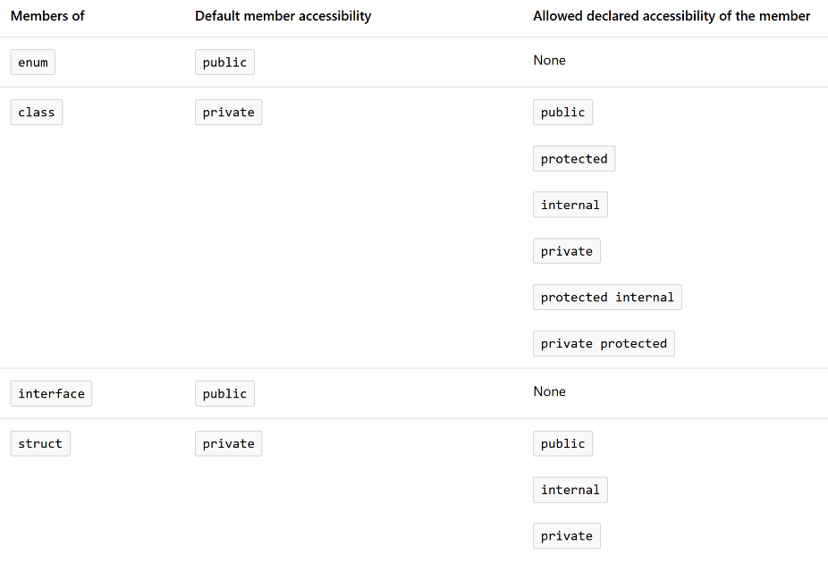
Default Access Protection / Restrictions

Slide 51
Indexer
An indexer is what C# calls the [] operator.
The indexer has a special syntax using "this"
class MyClass {
private int[] myArray = {1, 2, 3, 4, 5, 6};
public int this[int index] {
get { return myArray[index]; }
set { myArray[index] = value; }
}
}
MyClass mc = new MyClass;
Console.WriteLine(mc[0]); // Prints 1
Console.WriteLine(mc[4]); // Prints 5

Slide 52
Factory Pattern
Chaining methods to act upon a class is sometimes referred to as a factory pattern.
Example: a.Map(i => i * 20).Reduce()
Requires methods to return a reference of the class.

Slide 53
Collections Generics
System.Collections.Generic
List<type>
LinkedList<type>
HashSet<type>
SortedSet<type>
Queue<type>
Stack<type>
Dictionary<keytype, valuetype>

Slide 54
Example List
using System.Collections.Generic;
public static void MyFunction() {
List<double> list_of_doubles = new List<double>();
for (int i = 0;i < 100000;i++) {
list_of_doubles.Add(i)
}
Console.WriteLine(list_of_doubles.Count); // # of elements
Console.WriteLine(list_of_doubles[0]); // First double
list_of_double.Sort();
foreach (double d in list_of_doubles)
Console.WriteLine(d); // Print out every double in the list
}

Slide 55
Inheritance
Much like C++, classes, abstract classes, and interfaces can be derived or “inherited”. The syntax is simply a colon after the name of a class or more separated by a comma.
Multiple inheritance is not allowed in C#. However, you can implement multiple interfaces.
class Derived : SomeBaseClass {
// This class now has all of the members of SomeBaseClass
}

Slide 56
Interface
Interfaces contain the “signature” of a method, property, or event.
C# programmers typically put a capital I in front of the name to denote that it is an interface: IMyInterface
interface IMyInterface {
void SomeMethod(); // Notice no code goes here
}
class MyClassThatImplementsIMyInterface : IMyInterface {
// This class is telling C# that it will implement all methods in IMyInterface
void SomeMethod() { // This implements IMyInterface.SomeMethod }
}
All interface members are public and cannot be changed. Notice there is no "public void SomeMethod()" in the class. Doing so would cause a compiler error.

Slide 57
Override
The override keyword is required to modify an abstract or virtual implementation of a method, property, event, or indexer.
You cannot override a non-virtual or non-abstract method!
abstract class SomeClass {
abstract public int SomeMethod();
}
class MyClass : SomeClass {
public override int SomeMethod() {
// override is required here to tell C# that
// you know you’re overriding the
// abstract class’ method
}
}

Slide 58
New
What if I don’t want to override a base class’ method, and instead, I want to create a brand new one?
Use the new keyword
public class Base {
public virtual void Func() {}
}
public class Derived : Base {
public new void Func() { }
}
Derived.Func() is now a totally new function, which hides Base.Func()
You can still call Base.Func() from Derived, you just have to specify it as “Base.Func()”
DO NOT use override and new together. It makes no sense and will cause a compiler error

Slide 59
Accessing Base Classes
“as” keyword
var i = someobject as String;
the “as” attempts to typecast someobject into a String using dynamic casting
IF the “as” keyword cannot dynamically cast, then var i will be null.
Use conventional typecasting to have C# throw an exception
var i = (string)someobject;

Slide 60
Events
Events allow a delegate (function) to be "registered". When the event is signaled, each function registered gets called.
Events must have a delegate to denote the type of arguments the event handlers receive
Events must have an "event" for observers to subscribe to

Slide 61
Event Example
class MyClass {
// This delegate shows that any event handler we subscribe
// will take a generic sender and EventArgs arguments
public delegate EventHandler(object sender, EventArgs e);
// The event keyword creates the event. We put EventHandler
// so that when we subscribe to SomeEvent, we know which
// arguments we'll get (sender and e).
public event EventHandler SomeEvent;
}

Slide 62
Calling Event Handlers
You can call all of the event handlers subscribed to an event by calling the event as a function:
public event EventHandler SomeEvent;
public void SendEvent() {
// This means we have subscribers
if (SomeEvent != null)
// This calls all event handlers
SomeEvent(this, new EventArgs());
}

Slide 63
Lambda Functions
Functions in C# can be anonymous functions, called lambda functions.
https://learn.microsoft.com/en-us/dotnet/csharp/language-reference/operators/lambda-expressions
Syntax: (parameter list) => { return value; }
Useful with delegates to pass as a first-class parameter.

Slide 64
Lambda Example
var lst = new List<int>();
lst.Add(10);
lst.Add(20);
lst.Add(30);
lst.Add(40);
lst.ForEach((i) => { Console.WriteLine(i); });

Slide 65
Parallel Programming
System.Threading
System.Threading.Tasks
Contains the Task<> objects
Contains the Parallel Class
Parallel.For
Parallel.ForEach
Parallel.Invoke
https://learn.microsoft.com/en-us/dotnet/api/system.threading.tasks.parallel

Slide 66
Easiest Invocation
Use the Parallel.* suite of functions
C# will automatically manage the threads for you
Must have: using System.Threading.Tasks;
Parallel.For(start, finish, function for each iterator)
start is inclusive, and is usually 0
finish is exclusive, and is usually N
The function is usually a lambda function, which is given the iterator i
Parallel.For(0, 10, i => { });
Executes the lambda function for each iteration in the for loop in parallel.

Slide 67
Parallel For Example
using System.Threading.Tasks;
class Px {
public static void Main(string[] args) {
long[] z = new long[20];
// The following executes a for loop where i = [0..20].
// This means that 21 threads are spawned and ran concurrently
// We use i => which is the lambda where i is which i the For loop is running
// Be careful because i will NOT be 0, 1, 2, 3, .., 20 in that order.
Parallel.For(0, 20, i => {
z[i] = DateTime.Now.Ticks;
});
// z[0] will store when the parallel for executed this thread with i = 0
// z[1] will store when the parallel for executed this thread with i = 1
// ...etc...
}
}

Slide 68
Task Async Pattern (TAP)
C# offers two keywords for asynchronous function calls:
async and await
These require using the Task and Task<> objects from System.Threading.Tasks

Slide 69
Other Patterns
C# also offers two other patterns (DO NOT USE THESE IN COSC365!)
Event Async Pattern (EAP)
Asynchronous Programming Model (APM)
These models generate odd code for the newer CLR virtual machines, so they should be avoided, but they still may be used!

Slide 70
Task.Run
In System.Threading.Tasks
Task.Run(() => { //Do something here });
This will run a new task in its separate thread. Task.Run returns a Task structure or Task<T> structure if you need to return a value from Task.Run
public async Task<T> MyFunc() {
return await Task.Run(() => {
int ret = 0;
for (int i = 0;i < 10000000;i++)
ret += i;
return ret;
});
}

Slide 71
Task and Task<T> structure
Task<T> structure returns a result in the property .Result
T is a generic type, so I can return a result as any type
Task and Task<T> have two useful members
The property IsCompleted. Returns true if the task is done, false otherwise
The function .Wait(). This function will pause your current thread until the task is done.

Slide 72
Waiting on Tasks
Eventually, we need to wait for the tasks to complete.
Task.Wait()
Task.WaitAll(task_iterable);
using (StreamReader sr = new StreamReader("TestFile.txt")) {

Slide 73
Asynchronous File Operations
StreamReader contains ReadToEndAsync() using the TAP pattern
Your code can call ReadToEndAsync() and move on to other things until reading the file is completed.
ReadToEndAsync() returns a reference to a Task that you can poll to see when it completes.

Slide 74
Synchronization
C# has a “lock” statement that will lock a critical section of code
private Object i = new Object();
public void SomeFunction() {
lock (i) {
// Execute code in here
// If another thread tries to use i, the lock statement will
// hang until the lock statement is released.
}
}

Slide 75
Synchronization Types
System.Threading
Semaphore
Mutex – Mutual exclusion
Monitor – Locks a single instance of an object
Barrier – a synchronization point that waits until all threads reach the barrier. Threads can be asynchronous before and after the barrier, but all threads will wait until ALL threads have reached the barrier.

Slide 76
Files
Files use a file stream object.
StreamReader/StreamWriter for text files.
BinaryReader/BinaryWriter for binary files.
There are others, but these are the easiest to use for most cases.
using System.IO;
The System.IO library contains all the file streaming classes.
https://learn.microsoft.com/en-us/dotnet/api/system.io?view=net-9.0

Slide 77
StreamReader Example
using (StreamReader sr = new StreamReader("TestFile.txt")) {
string line;
// Read and display lines from the file until the end of
// the file is reached.
while ((line = sr.ReadLine()) != null) {
Console.WriteLine(line);
}
}
// The sr reference goes out of scope after the using statement
// and it is "finalized" (i.e., closed).

Slide 78
Splitting Lines
ReadLine() gets you an entire line, but what if you need individual data?
Split the line and convert the data.
StreamReader sr = new StreamReader("TestFile.txt");
string line = sr.ReadLine();
string[] data = line.Split(' ', StringSplitOptions.RemoveEmptyEntries);
if (data.Length >= 2) {
int left = int.Parse(data[0]);
int right = int.Parse(data[1])
}
sr.Close();

Slide 79
IDisposable
The using () {} statement automatically runs an IDisposable interface.
https://learn.microsoft.com/en-us/dotnet/api/system.idisposable?view=net-9.0
This allows a "Dispose" method to be called after the using statement closes.

Slide 80
Binary Files
Binary files use the BinaryReader/BinaryWriter classes.
These classes have a Write that is overloaded (like crazy).
https://learn.microsoft.com/en-us/dotnet/api/system.io.binarywriter.write?view=net-9.0
The overloads allow any basic data types to be written.
The Read methods have ReadXXX(), where XXX is the data type to return.
ReadByte()
ReadInt32()
ReadDouble()

Slide 81
Opening Binary Files
BinaryReader/BinaryWriter require a stream object to wrap.
File.Open(filename, FileMode.Create) -- for writing
File.Open(filename, FileMode.Open) -- for reading
Hand the FileStream object to the BinaryReader/BinaryWriter.
using (var stream = File.Open(fileName, FileMode.Create)) {
using (var writer = new BinaryWriter(stream)) {
writer.Write(1.250F);
writer.Write("String");
writer.Write(10);
writer.Write(true);
}
}

